Slide 1
Niranda Flores
Bilingual / ESL Specialist
Region One ESC
niflores@esc1.net

Slide 2
Notes:
Districts have the choice to offer a bilingual program at secondary level. In ESL programs primary language plays a roles; however instruction is not in primary language. ESL instruction is in English with second language acquisition supports. In ESL pullout ONLY ELAR is provided by ESL certified teacher. ESL Content-based (wiggle five fingers) ALL CONTENT is taught by ESL certified teacher. ALL BILINGUAL PROGRAMS use instruction in the primary language to leverage English proficiency. For TBE early exit or late exit: primary language instruction reduces as the students are promoted from year to year. Dual language GOALS are bilingualism, biliteracy and socio-cultural competence.

Slide 3
Why were program implementation rubrics developed?
What is the purpose of the program implementation rubrics and associated tools?
Notes:
Clear guidance on how to ENHANCE AND EXPAND THE EFFECTIVENESS of bilingual/ESL programs in order TO INCREASE EL ACHIEVEMENT.
Stated in Ch 89 – by law in stature
Commisioner’s Initiative for DLI and Sheltered Instruction in ESL programs.
PROVIDE a tool for self-evaluation, ASSIST in developing next steps for campus and districts, PROVIDE action items for specific roles through checklists.

Slide 4
EL Program Models
Bilingual Education
Transitional
Early Exit
Transitional Late Exit
English as a Second Language (ESL)
ESL Content-Based
Dual Language One Way
Dual Language Two Way
ESL Pull-Out
Notes:
3 Rubrics with five categories. Each category and component applies to both models WITH SPECIFIC INDICATIONS OF VARIANCE NOTED.

Slide 5
Same Five Categories
Program Model Design
Staffing and Professional Development
Instructional Design: Lesson Planning & Curriculum
Instructional Design: Methods and Resources
Family and Community Engagement
Notes:
Each category has multiple components. Many components are the same across all three rubrics.
Activity – participants will break into groups according to the EL program model their district currently implements. In groups, participants will analyze all three rubrics and note the differences found in their program model. Either it includes it or it does not include it. Participants will present on the differences.

Slide 6
Below Basic Implementation
Enhanced Implementation
Exemplary Implementation
Basic Implementation
Notes:
Below Basic Implementation – there is no way for the students to access the ELPS
Basic Implementation – meet the minimum required by law
Anyone who files a waiver is BELOW BASIC
Rubrics are cumulative! Each level builds upon the previous level – similar to T-TESS and T-PESS.

Slide 7
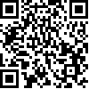
Group Activity
Break-up into three groups based on the program models you offer
ONLY ESL
ESL and Transitional Bilingual Education (early exit and/or late)
ESL, Transitional Bilingual Education AND Dual Language (one and/or two way)
Analyze program model rubric for your group and COMPARE it to the other rubrics
Annotate AHAs or MAJOR DIFFERENCES
http://bit.do/ELprogramrubrics
Notes:
Activity with link and QR code!

Slide 8
Planning Considerations
Campus or District
Bilingual Education or ESL Program
All or Targeted Campuses
Program Evaluation Team
district-based bilingual/ESL program leaders or other district leadership
campus administrators or campus-based bilingual/ESL coordinators
bilingual/ESL program teachers
instructional coaches/specialists that support bilingual/ESL or specific content areas
human resources specialists
parents/guardians of ELs, family liaisons, or other community members
Notes:
MOST EFFECTIVE: Rubrics can be utilized at both levels. ALIGNMENT between campus and district level is essential to program success; therefore, COLLABORATION is key.
CHOICES: prioritize one program at a time or evaluate both programs simultaneously. BENEFICIAL to create more than one team to focus on unique components of each program.
Consider size of district, staffing and number of EL students. CHOICES: district may include ALL CAMPUSES or select specific campuses (campuses can either be selected as feeder patterns, level, or because we want to showcase what’s going on there or because we want them to reflect over practices).

Slide 9
Scoring Tool
Stakeholder
Checklists
Rubric
Is the foundational piece and includes:
hyperlinks to outside resources
state rule citations
explanatory footnotes
research references
glossary of acronyms
Is used to quantify the level of implementation and includes:
planning template
evidence for score rationale
next steps
long-terms goals
Focus on teachers, campus administrators and district administrators
Provide succinct and targeted steps for each role to execute
Notes:
AFTER the planning considerations and team development it is VITAL for all stakeholders to become familiar with the materials available. For a more thorough evaluation, it is recommended to use the online version of the rubrics, so they can take advantage of ALL THE HYPELINKS.

Slide 10
Additional levels are included to track incremental progress.
Notes:
Scoring tool categories were divided into sub-categories to provide districts opportunities for flexibility and improvement.
Some percentages are also mentioned in the scoring tool levels to provide practical attainment.

Slide 11
Preview
Preview
Take notes
Meet and Evaluate
Meet as team
Decide upon ONE rating
Repeat
Preview
Meet and Evaluate
Select and Train
Schedule
Select a team leader
Train all team members
Set a timeline
Begin with Program Model Design
Notes:
These steps are a the recommended process to follow after a THE TEAM has been created. Possible arrangements could be through Zoom meetings as well as each team member REVIEW on your own and then come together. Any other ideas?
SELECT AND TRAIN: team leader will coordinate meetings facilitate process; ensure all team members are familiar with resources and understand the purpose of the program evaluation process
SCHEDULE: create a timeline to meet as a team; decide on the order under which the rest of the categories will be evaluated (recommendation is begin with program design)
PREVIEW: takes step BEFORE the initial evaluation meeting - EACH MEMBER previews the first category and takes notes on the scoring tool to justify scores
MEET AND EVALUATE: discuss the first category and UNANIMOUSLY decide on ONE RATING; EXAMINE considerations for next step based on score
NO SPECIFIC ORDER TO EVALAUATE THE CATEGORIES!

Slide 12
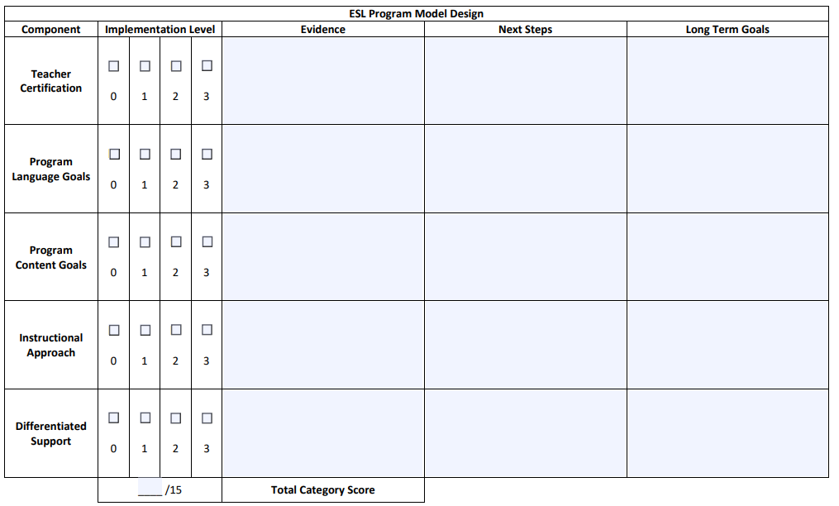
Notes:
IMPLEMENTATION LEVELS match rubric levels
TOTAL POINTS are dependent on the number of components per category.
EVIDENCE: included both the positive (glows) and the areas of improvement (grows)
For any BELOW BASIC: reflective question would be WHAT ARE WE DOING NOW!

Slide 13
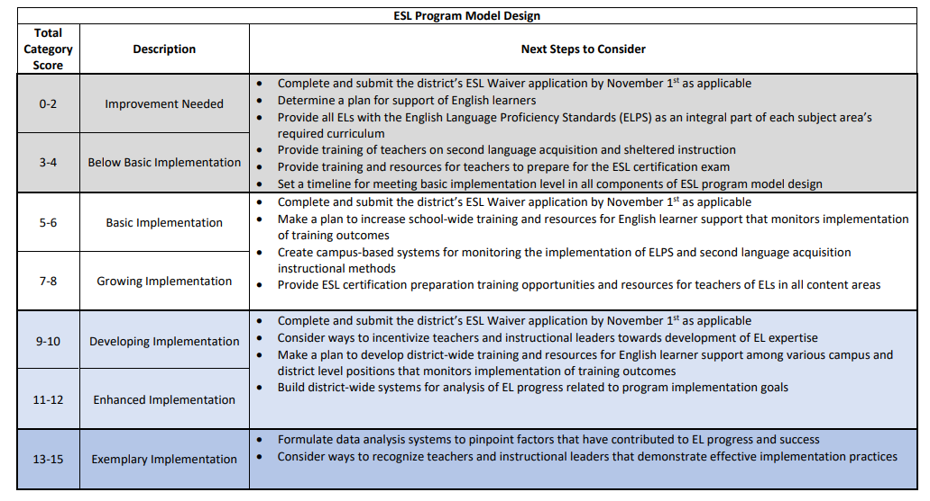
Notes:
ADDITIONAL LEVELS within the FIRST THREE rubric levels provided to allow districts to demonstrate more incremental growth.
ADDITIONAL LEVELS also allow us to MOVE INCREMENTALLY through levels.

Slide 14
Virtual Methods for Collaboration
shared electronic folders
webinar formats
conference calls
Additional Input
surveys
interviews
reflection tools
Notes:
Additional input is from other members who are not participating in the evaluation process.

Slide 15
Considerations
Consolidate related next steps
Determine high priorities based on student needs
Involve additional stakeholders
Set a timeframe
Create a timeline
Include immediate actions and long-term goals
Include when and how to monitor action plan
Communicate in a timely manner
Brainstorm how to build investment (incentivize action plan)
Synchronize action plan
Notes:
LAST STEP occurs AFTER all rubric categories have been evaluated and scored. The TEAM will synthesize NEXT STEPS and LONG TERM GOALS into an ACTION PLAN.
CONSIDERATIONS: build the BEST PROGRAM based on WHAT WE HAVE and WHO WE SERVE.
When creating an action plan, take into considerations all other projects taking place at the district.
**DO NOT SEE THIS AS YET ANOTHER INITIATIVE – Rubric SHOULD CONNECT with other initiatives (school improvement)

Slide 16
Notes:
SHARES the responsibility and HOLDS EVERYONE ACCOUTABLE
Used to target INDIVIDUAL ACTION STEPS for SPECIFIC ROLES
Helps ENSURE FIDELITY of implementation

Slide 17
Establish checkpoints for priority goals
Meet as a team
Collect feedback
Incorporate both qualitative and quantitative
Reflect over progress
Adjust plans as needed
Notes:
Collect feedback from as many stakeholders as possible.
Make adjustments based on overall needs of students, stakeholders – STAY ALIGNED TO PRIORITY GOALS

Slide 18
Additional Support
Region One Bilingual/ESL Department
Phone: 956-984-6158
Email: niflores@esc1.net
Resource: TEA English Learner Program Implementation

